Slide 1
What is Infrastructure as Code? An Introduction & Live Workshop
07/25/2022
Nashville Innovation and Delivery Center (NIDC)
Mitchell Ciupak

Slide 2
Agenda
Introduction
What is Infrastructure as Code?
IaC Tools
What is GitOps?
What is Terraform?
Workshop
GitHub and Contribution Rules
Using Terraform
Using Terraform Plugins

Slide 3
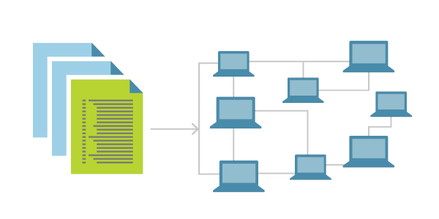
What is IaC (Infrastructure as Code)?
The Problem w/ Manual Configuration
Manually configuring your cloud infrastructure allows you to easily begin using new service offerings to quickly prototype architectures, however it comes with many downsides:
It is easy to mis-configure a service through human error.
It is difficult to manage or move the expected state of your configuration.
It is difficult to transfer knowledge of the configurations to other team members.
Infrastructure as Code (IaC)
You simply write a configuration in a script to automate the creation, updates, and destruction of your cloud infrastructure.
IaC is a blueprint for your infrastructure.
IaC can be easily shared, versioned, and acts as an inventory for your cloud infrastructure.

Slide 4




IaC (Infrastructure as Code) Tools
Popular Infrastructure as Code Tools
Declarative v. Imperative
There are two types of these tools. Declarative and Imperative. Declarative tools are explicit, largely non-conditional, and are typically written in JSON, YAML, or XML. Imperative tools tie into programming languages and offer the ability to be nested in conditionals or loops of the language, making them prone to misconfiguration.
Declarative Examples
Azure Blueprints
AWS CloudFormation
GCP Cloud Deployment Manager
Terraform
Imperative Examples
AWS CKD
More About Terraform
Terraform is a declarative IaC tool with its own language that supports loops, complex data structures, and dynamic blocks to a limited functional capacity. Offering the best of both worlds.

Slide 5
Infrastructure Management Tools
Provisioning v. Deployment v. Orchestration
Provisioning
Deployment
Orchestration

Slide 6
What is GitOps?
Provisioning v. Deployment v. Orchestration - Filler
Provisioning
Deployment
Orchestration

Slide 7
Terraform – A Deeper Dive
Terraform Re-Introduction
Terraform is a declarative IaC tool
Also…
Terraform Lifecycle
Change Automation
Execution Plans
Resource Graphs
Use Cases

Slide 8
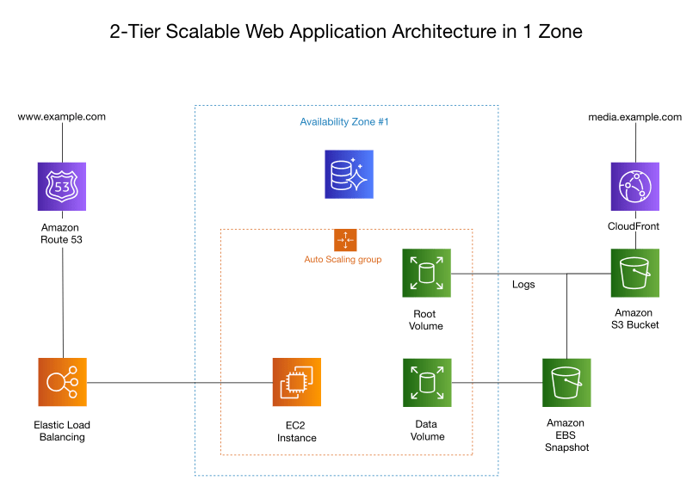

Slide 9
Interim Q&A

Slide 10
Workshop
10 to 20 minutes

Slide 11
Let’s all get on the same page and workshop demo. What we are doing?
Provisioning v. Deployment v. Orchestration
Provisioning
Deployment
Orchestration
Notes:
def Introduce_GitOps(:
# V. What is GitOps?
return
def Introduce_Terraform(:
# VI. Terraform Re-Intro
# a. What is Terraform Again?
# b. Terraform Lifecycle
# c. Change Automation
# d. Execution Plans
# e. Resource Graphs
# f. Use Cases
return
def Introduction(:
Introduce_IaCBasic(
Introduce_IaCTools(
Introduce_InfraLifecycles(
Introduce_InfraTools(
Introduce_GitOps(
Introduce_Terraform(
def Introduce_TerraformSpotifyPlugin(:
return
def Introduce_ContributionRules(:
return
def Workshop(:
Introduce_Terraform(
Introduce_TerraformSpotifyPlugin(
Introduce_ContributionRules(
def Agenda(:
Introduction(
Workshop(
if __name__ == __main__:
Agenda(

Slide 12
Let’s talk about how to make a PR
Step 1: Create a GitHub Account
Step 2: Find The Project Repository
Step 3: Fork and Being to Add Your Song as Code to ./main.tf
Step 4: Create a Pull Request (PR) to Merge Your Code back into the Project
Step 5: Merge the Pull Request
Step 6: Deploy!
A Detailed List of Steps 1-4 is in the Appendix
Notes:
def Introduce_GitOps(:
# V. What is GitOps?
return
def Introduce_Terraform(:
# VI. Terraform Re-Intro
# a. What is Terraform Again?
# b. Terraform Lifecycle
# c. Change Automation
# d. Execution Plans
# e. Resource Graphs
# f. Use Cases
return
def Introduction(:
Introduce_IaCBasic(
Introduce_IaCTools(
Introduce_InfraLifecycles(
Introduce_InfraTools(
Introduce_GitOps(
Introduce_Terraform(
def Introduce_TerraformSpotifyPlugin(:
return
def Introduce_ContributionRules(:
return
def Workshop(:
Introduce_Terraform(
Introduce_TerraformSpotifyPlugin(
Introduce_ContributionRules(
def Agenda(:
Introduction(
Workshop(
if __name__ == __main__:
Agenda(

Slide 13

Example of what to do
Live Demo
Notes:
Select a song from The EasyRetro Scrum Board: https://easyretro.io/publicboard/K4TJLfaixtZPhOqz3R0NH6xarN12/94132534-22e6-4fec-b883-5439a2bfd9e8
Add your name to the Song Card by clicking on the three dots in the corner of the card and clicking ‘Edit’
Move your song card to in progress and start coding (Full Instructions in Appendix
Create the fork
Edit the file in browser
Propose Change
Create a Pull Request
(Just Mitchell) Merge the PR
After all PRs are Merged, Deployment
Remote into PC
Authenticate to Spotify
docker run --rm -it -p 27228:27228 --env-file ./.env ghcr.io/conradludgate/spotify-auth-proxy
terraform init
terraform apply
yes
Share Playlist

Slide 14
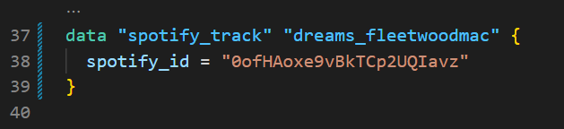
Let's do it
Start By Selecting a Song from The Board
Link to Scrum Board: https://easyretro.io/publicboard/K4TJLfaixtZPhOqz3R0NH6xarN12/94132534-22e6-4fec-b883-5439a2bfd9e8
Do Some Coding
Here is an example of a song in IaC
Add a data element like this to main.tf and add the element to the list of tracks!
Create A Pull Request
Link to Instructions: https://github.com/mitchellciupak/spotify-playlist-with-terraform-brownbag#contributing-rules
After Merging all the PRs, We Will Deploy!

Slide 15
Closing Q&A

Slide 16
Appendix

Slide 17
Contributing Rules – Steps 1 & 2
Step 1: Create or Sign Into Your GitHub Account
Please Refer to the ./presentation/IaC_brownbag_CreateAGitHubAccount.pdf document for instructions on how to signup for GitHub, otherwise sign into your account at https://github.com/.
Step 2: Navigate to The 'spotify-playlist-with-terraform-brownbag' Repository
Use the following link to get to the 'spotify-playlist-with-terraform-brownbag' Repository: https://github.com/mitchellciupak/spotify-playlist-with-terraform-brownbag

Slide 18
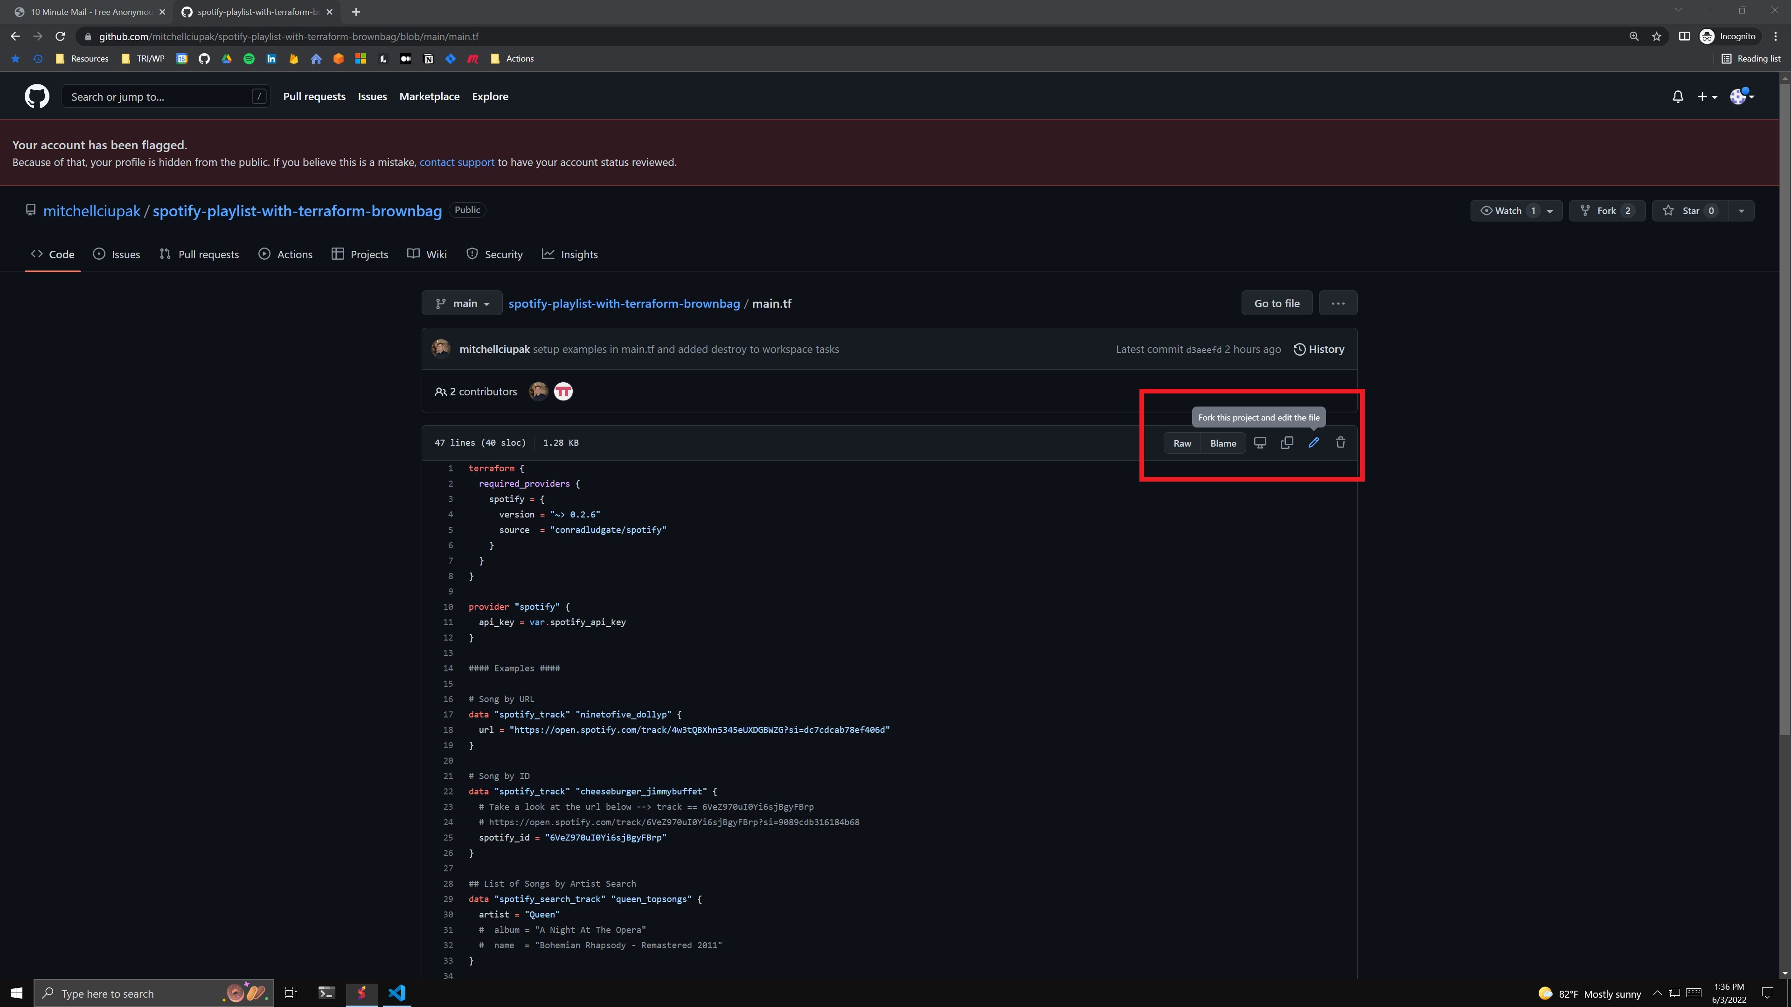
Contributing Rules – Step 3
Step 3a: Start Editing ./main.tf
Go to ./main.tf and select 'fork this project and edit this file' in the top right corner. This will automatically fork the original repository into your own account.

Slide 19
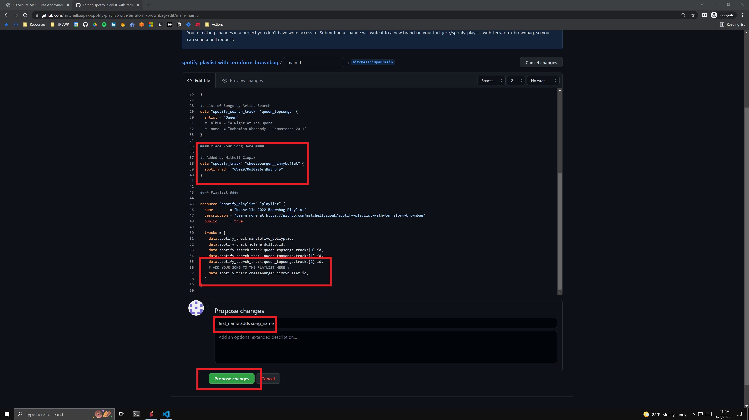
Contributing Rules – Step 3 (cont.)
Step 3b: Add your song to ./main.tf as code
Add your song as a data element. Add that data element to the playlist. Click 'Propose Change'.

Slide 20
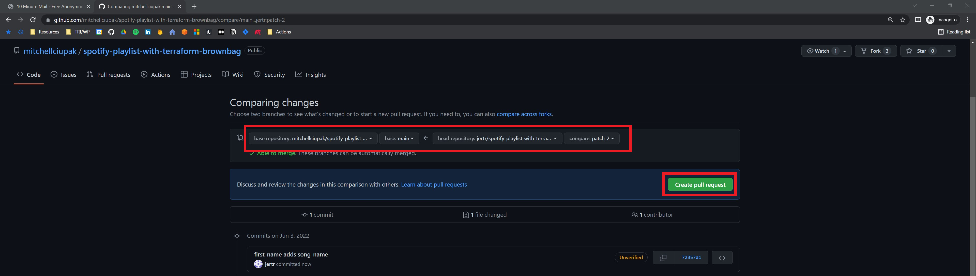
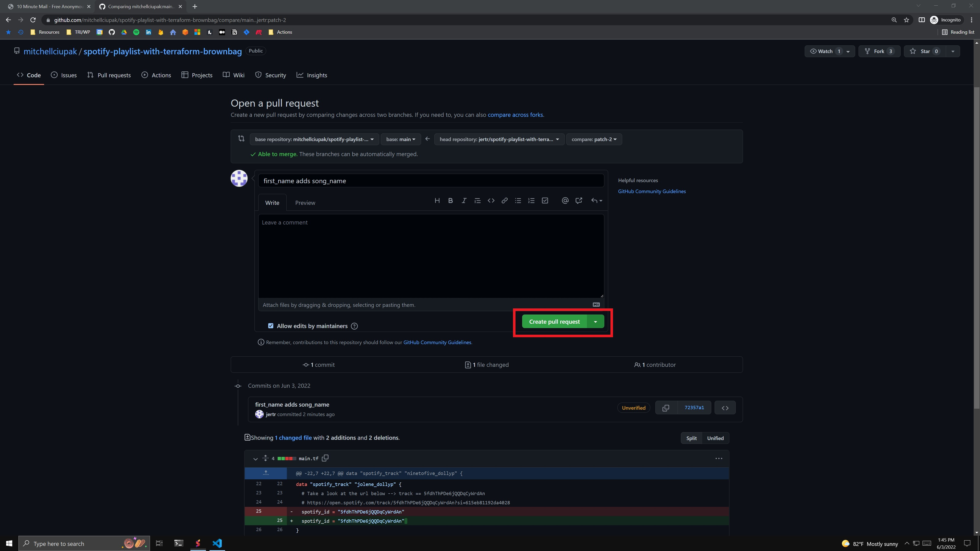
Contributing Rules – Step 4
Step 4a: Make a Pull Request
Validate that you are requesting to pull the correct branch into the correct branch and click 'Create Pull Request’. (top image)
Click ‘Create Pull Request’ (bottom image)

Slide 21
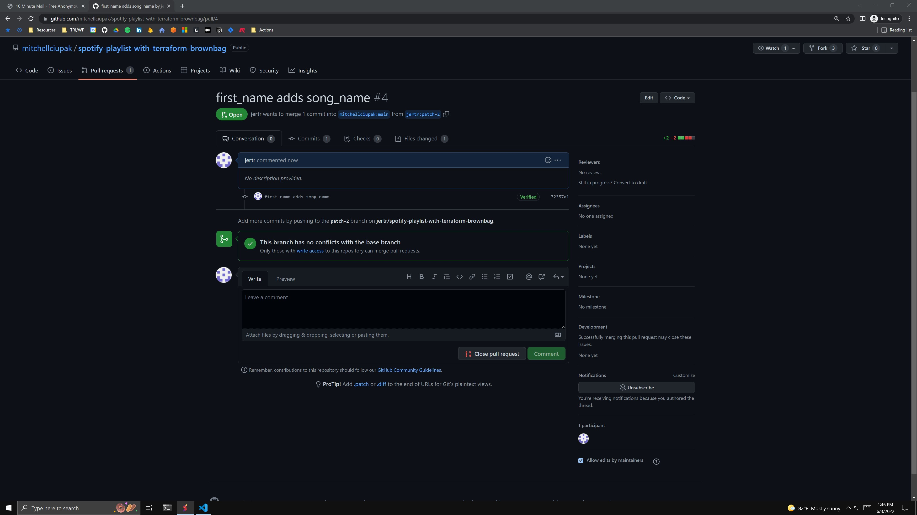
Contributing Rules – Step 4 (cont.)
Step 4b: Add your song to ./main.tf
Once you are on a page similar to this, you have successfully made a PR. Move your Card into the ‘In Review’ Column.
Notes:
Form – https://forms.office.com/r/wmmqzy196Q
Form Results - https://forms.office.com/Pages/DesignPageV2.aspx?origin=NeoPortalPage&subpage=design&id=b-DkZWPyH0y-y5DeuMLZ_4VqdpFK6xFEuA-eUuBAjn1UNEpZMFk3TVlGNzhIME5SQzlQWjBRNFVUVC4u&analysis=true
EasyRetro Board (Scrum Board) - https://easyretro.io/publicboard/K4TJLfaixtZPhOqz3R0NH6xarN12/94132534-22e6-4fec-b883-5439a2bfd9e8

